Slide 1
Depth-First Search
Algorithms & Data Structures
ITCS 6114/8114
Dr. Dewan Tanvir Ahmed
Department of Computer Science
University of North Carolina at Charlotte

Slide 2
Outline and Reading
Definitions (§6.1)
Subgraph
Connectivity
Spanning trees and forests
Depth-first search [Cormen]
Algorithm
Example
Properties
Analysis
Applications of DFS
Path finding
Cycle finding

Slide 3
Subgraphs
A subgraph S of a graph G is a graph such that
The vertices of S are a subset of the vertices of G
The edges of S are a subset of the edges of G
A spanning subgraph of G is a subgraph that contains all the vertices of G
Subgraph
Spanning subgraph

Slide 4
Connectivity
A graph is connected if there is a path between every pair of vertices
A connected component of a graph G is a maximal connected subgraph of G
Connected graph
Non connected graph with two connected components

Slide 5
Trees and Forests
A forest is an undirected graph without cycles
A (free) tree is an undirected graph T such that
T is connected
T has no cycles
This definition of tree is different from the one of a rooted tree
The connected components of a forest are trees
Forest
Tree

Slide 6
Spanning Trees and Forests
A spanning tree of a connected graph is a spanning subgraph that is a tree
A spanning tree is not unique unless the graph is a tree
Spanning trees have applications to the design of communication networks
Graph
Spanning tree

Slide 7
Depth-First Search
Depth-first search (DFS) is a general technique for traversing a graph
A DFS traversal of a graph G
Visits all the vertices and edges of G
Determines whether G is connected
Computes the connected components of G
Computes a spanning forest of G
DFS on a graph with n vertices and m edges takes O(n + m ) time
DFS can be further extended to solve other graph problems
Find and report a path between two given vertices
Find a cycle in the graph

Slide 8
Depth-First Search [Cormen]
Strategy:
search “deeper” in the graph whenever possible.
DFs explores edges out of the most recently discovered vertex v that still has unexplored edges leaving it.
Once all of v’s edges have been explored, the search “backtracks” to explore edges leaving the vertex from which v was discovered.
This process continues until we have discovered all the vertices that are reachable from the original source vertex.
If any undiscovered vertices remain, then depth-first search selects one of them as a new source, and it repeats the search from that source.
The algorithm repeats this entire process until it has discovered every vertex.

Slide 9
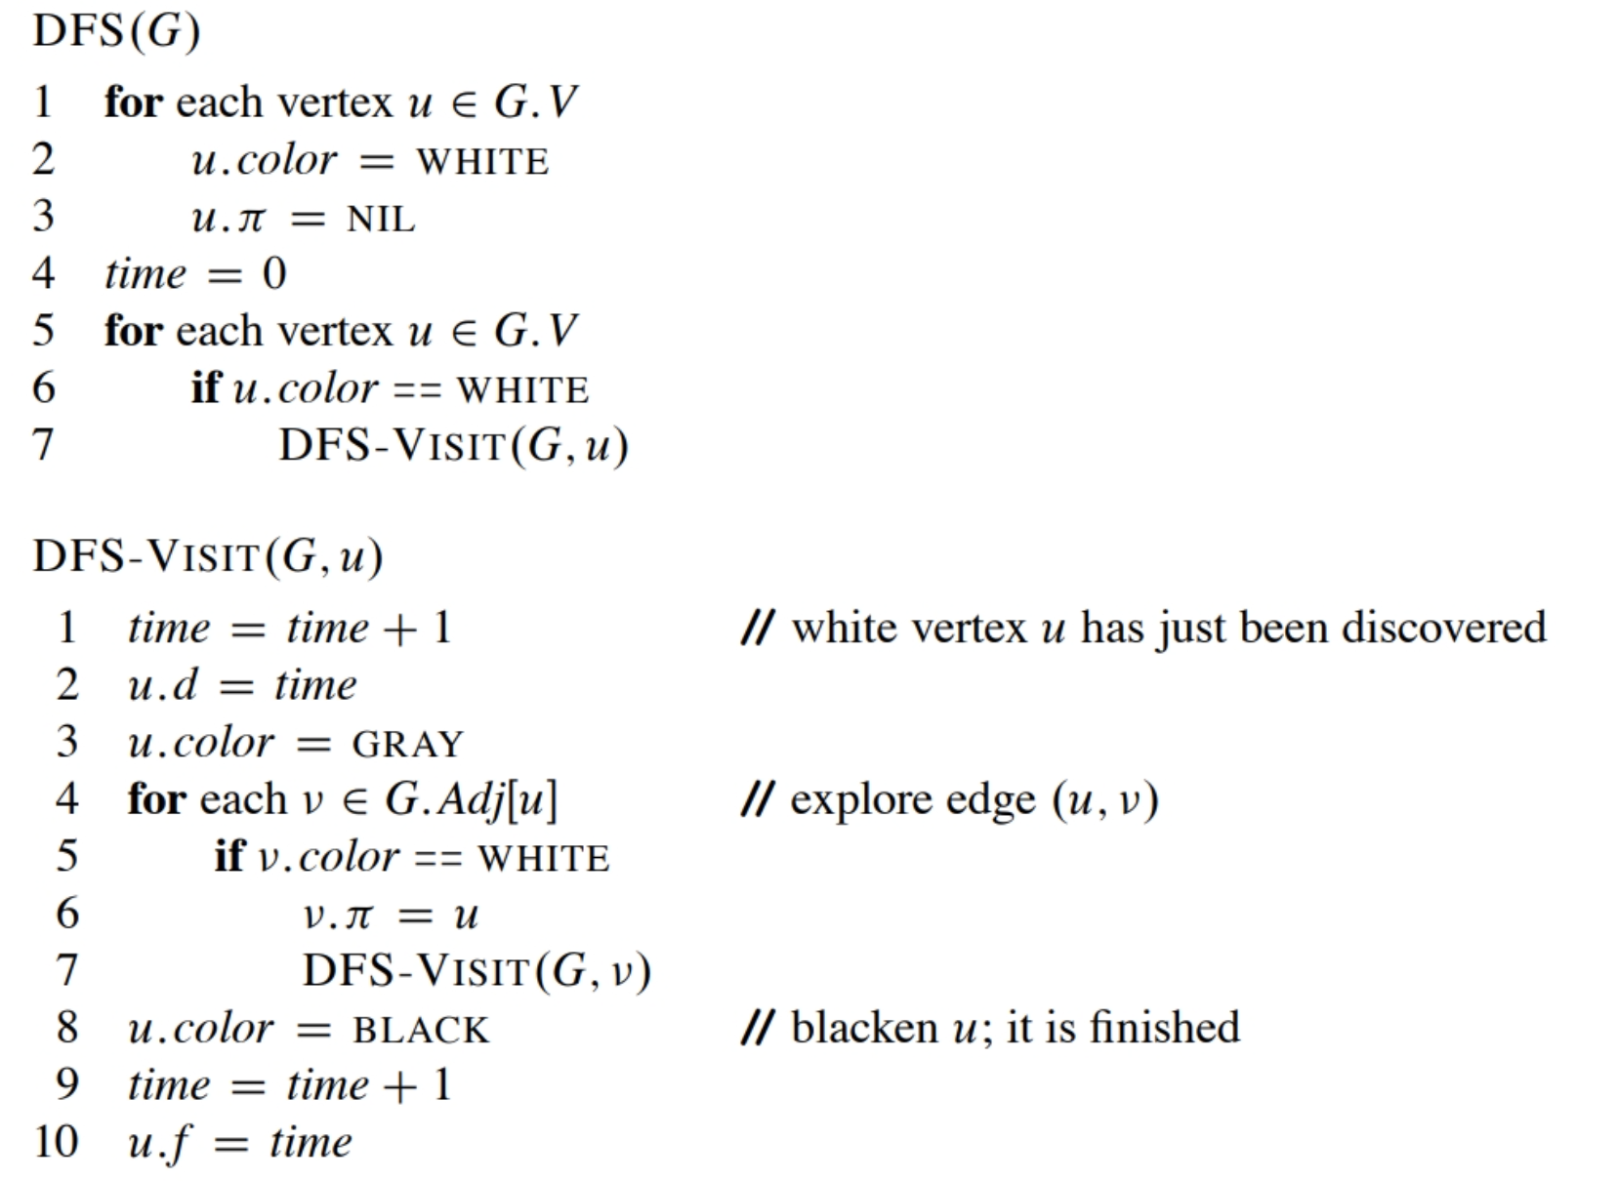
DFS Algorithm [Cormen]
u’s predecessor attribute
Each vertex is initially white, is grayed when it is discovered in the search, and is blackened when it is adjacency list has been examined completely.,

Slide 10
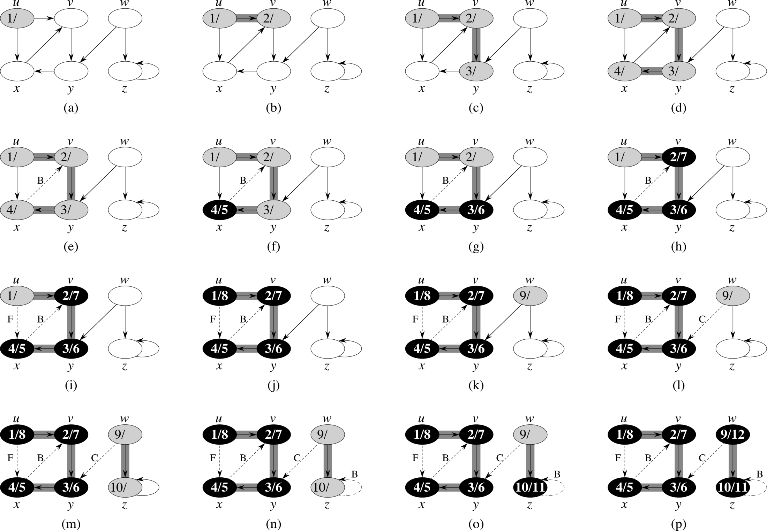
DFS Example [Cormen]

Slide 11
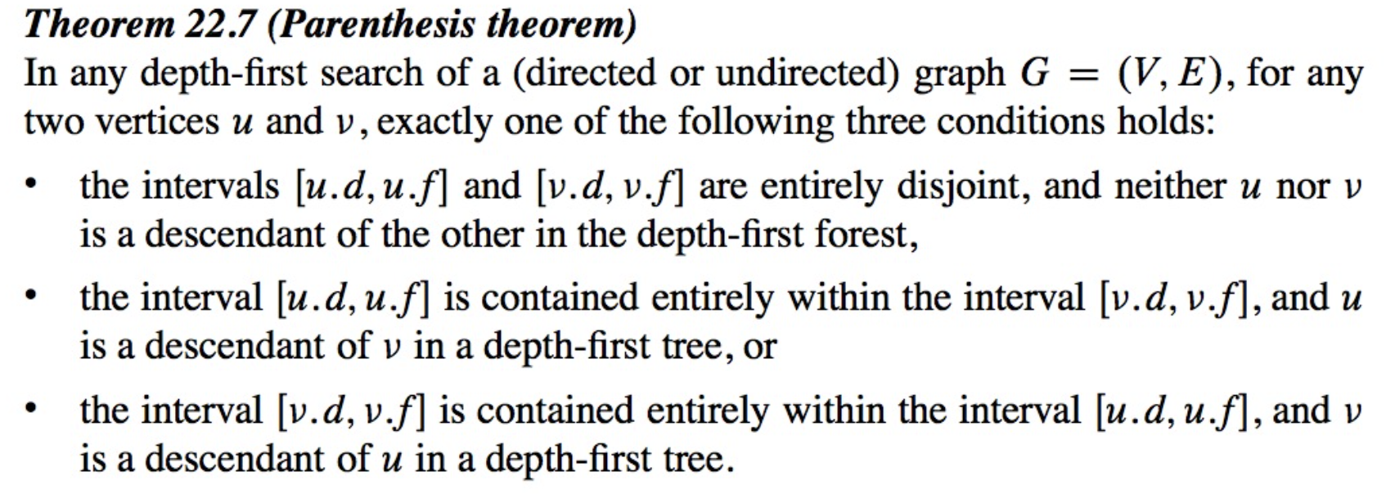
DFS Properties

Slide 12
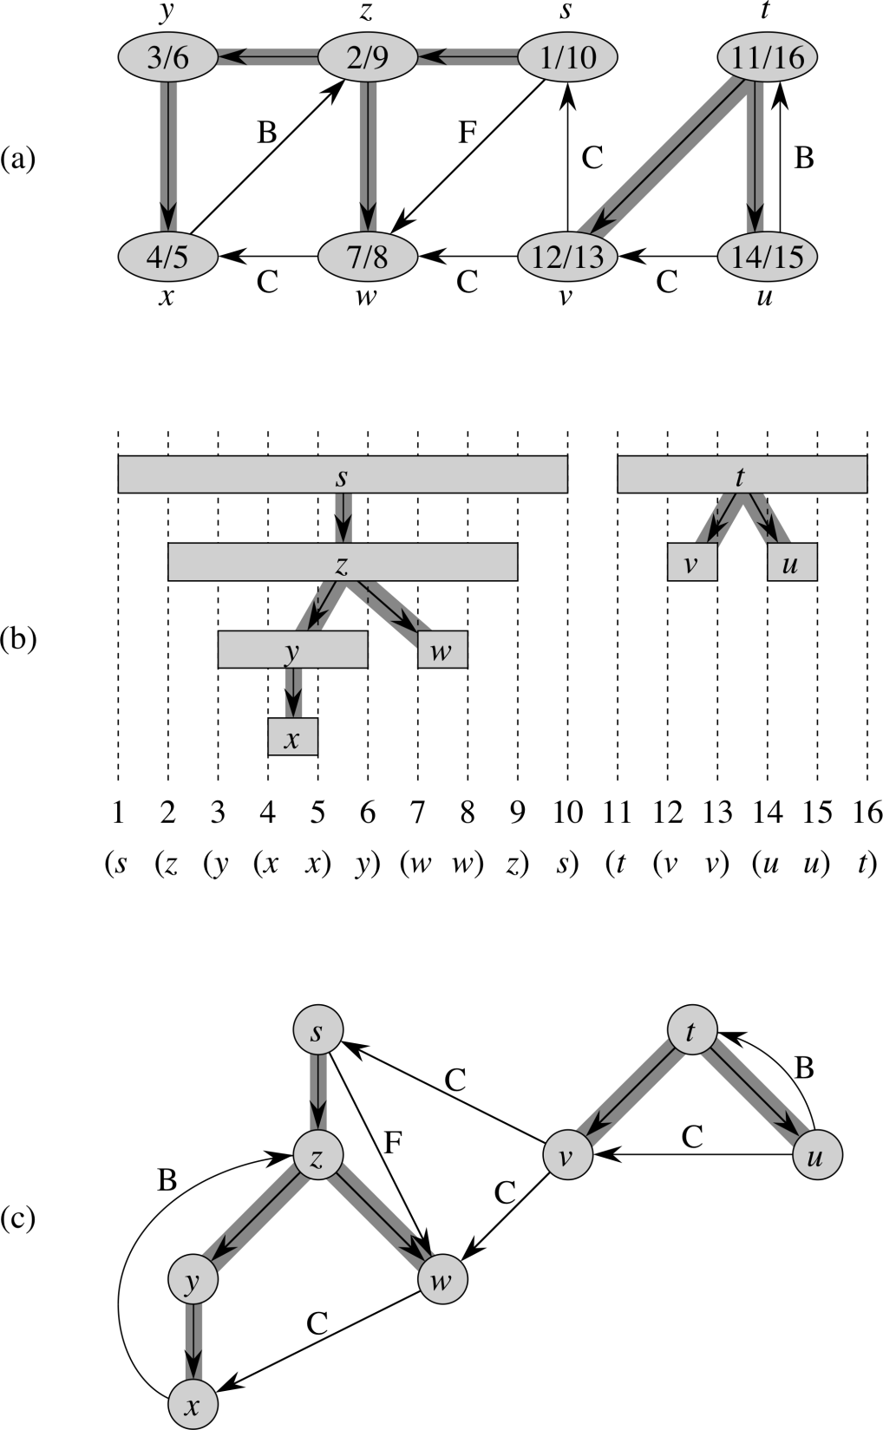
DFS Algorithm

Slide 13
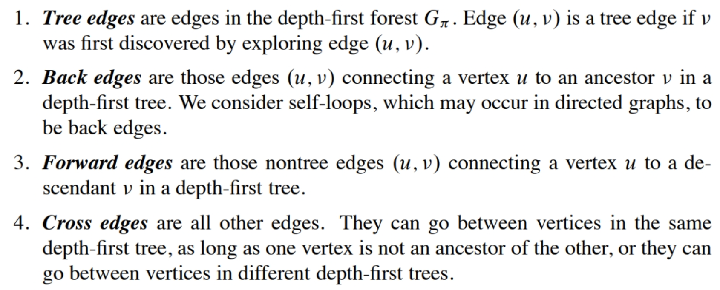
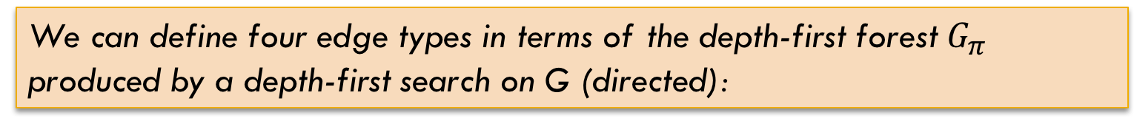
DFS Properties
We can define four edge types in terms of the depth-first forest $G_{π}$ produced by a depth-first search on G (directed):
What if Graph is undirected?
In a depth-first search of an undirected graph G, every edge of G is either a tree edge or a back edge.

Slide 14
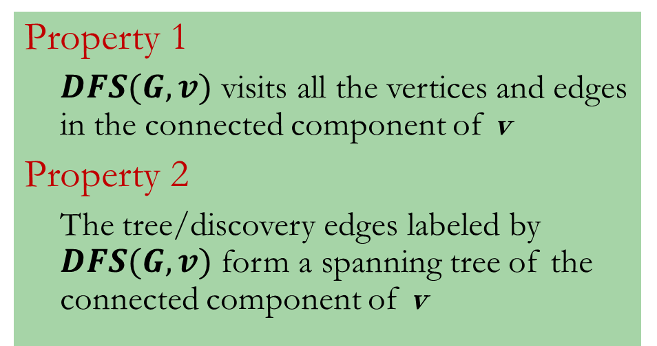
Properties of DFS
Property 1
$DFS(G, v)$ visits all the vertices and edges in the connected component of v
Property 2
The tree/discovery edges labeled by $DFS(G, v)$ form a spanning tree of the connected component of v
A
B
D
E
C

Slide 15
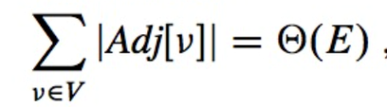
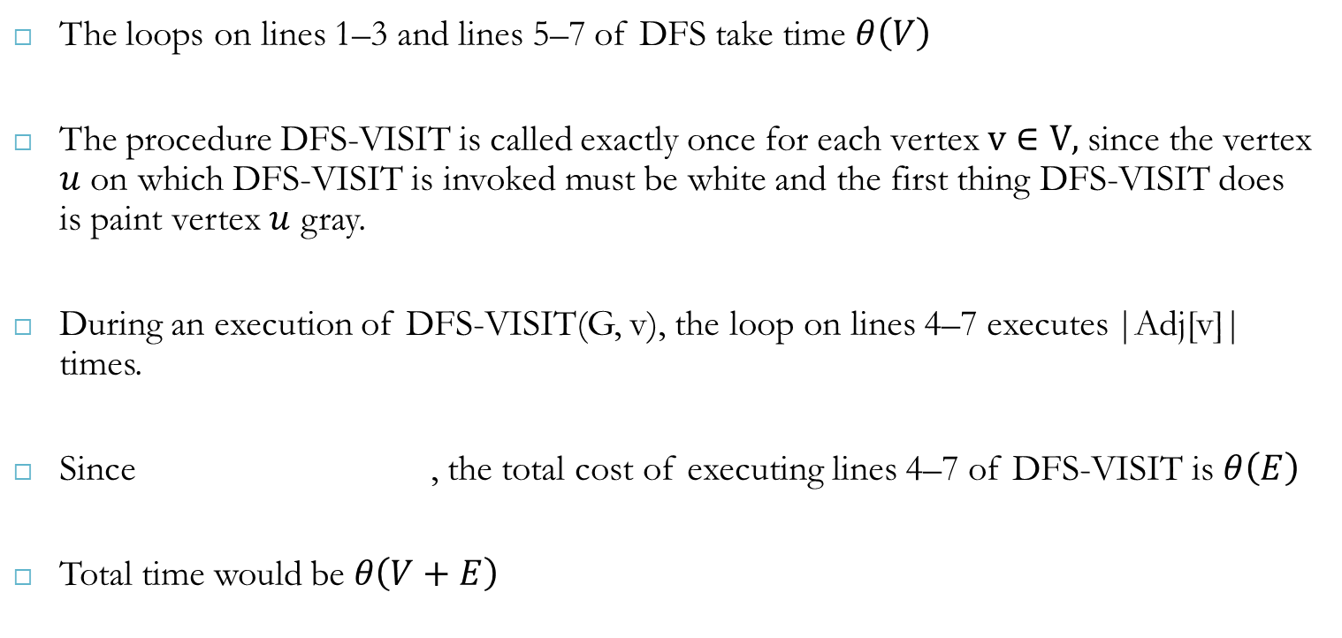
What is the running time of DFS?
The loops on lines 1–3 and lines 5–7 of DFS take time $θ\left(V\right)$
The procedure DFS-VISIT is called exactly once for each vertex $v∈V,$since the vertex $u$ on which DFS-VISIT is invoked must be white and the first thing DFS-VISIT does is paint vertex $u$ gray.
During an execution of DFS-VISIT(G, v), the loop on lines 4–7 executes |Adj[v]| times.
Since , the total cost of executing lines 4–7 of DFS-VISIT is $θ\left(E\right)$
Total time would be $θ\left(V+E\right)$

Slide 16
DFS Algorithm [Cormen]
u’s predecessor attribute

Slide 17
Path Finding
If DFS keeps parent information, it is easy.
Alternatively:
We can specialize the DFS algorithm to find a path between two given vertices u and z using the template method pattern
We call DFS(G, u) with u as the start vertex
We use a stack S to keep track of the path between the start vertex and the current vertex
As soon as destination vertex z is encountered, we return the path as the contents of the stack

Slide 18
Cycle Finding
If DFS keeps parent information, it is easy.
Alternatively:
We can specialize the DFS algorithm to find a simple cycle using the template method pattern
We use a stack S to keep track of the path between the start vertex and the current vertex
As soon as a back edge (v, w) is encountered, we return the cycle as the portion of the stack from the top to vertex w

Slide 19
Reference
Algorithm Design: Foundations, Analysis, and Internet Examples. Michael T. Goodrich and Roberto Tamassia. John Wiley & Sons.
Introduction to Algorithms. Thomas H. Cormen, Charles E. Leiserson, Ronald L. Rivest, Clifford Stein.

Slide 20
Thank you!

